Slide 1
Computer network session 8
Transport layer
Santoso Budijono

Slide 2
Learning outcomes
LO 1: Describe basic structures of network
LO 2: Explain basic concepts of network

Slide 3
topics
TRANSPORT LAYER SERVICES
TCP
UDP
SCTP

Slide 4
TRANSPORT LAYER
SERVICES
Process-to-Process Communication
A process is an application-layer entity (running program) that uses the services of the transport layer.
Port Numbers
a. Port numbers are integers between 0 and 65,535 (16 bits).
b. Port numbers together with IP number create Socket Address
Multiplexing and Demultiplexing
a. Multiplexing is many to one – entity accepts items from more than one source – performs at source
b. Demultiplexing is one to many – entity delivers items to more than one destination – performs at destination
Flow Control
a. Pushing – Pulling – flow control need to control Pushing-Pulling from consumer to producer.
b. Handling flow Control
Error Control
In the Internet, because the underlying network layer (IP) is unreliable, we need to make the transport layer reliable if the application requires reliability. Reliability can be achieved to add error-control services to the transport layer.
Congestion Control
a. Connectionless service
b. Connection-Oriented Service

Slide 5
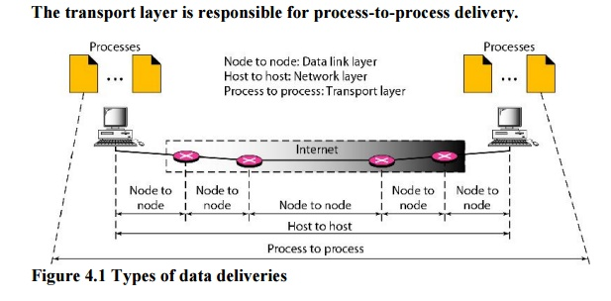
TRANSPORT LAYER
Process to process delivery

Slide 6
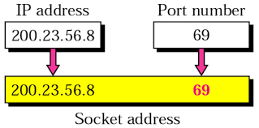
TRANSPORT LAYER
Port numbers – socket address
Port Numbers
a. Port numbers are integers between 0 and 65,535 (16 bits).
Port number correlation with application, each application has unique port number
b. Port numbers together with IP number create Socket Address

Slide 7
TRANSPORT LAYER
Multiplexing - demultiplexing
Allows multiple applications to use the network simultaneously by assigning unique identifiers (ports) to each application
Multiplexing :
  Gathering data from multiple application processes of sender, enveloping that data with header and sending them as a whole to the intended receiver.
Demultiplexing :
  Delivering received segments at receiver side to the correct application at app layer process.

Slide 8
Transport layer
Flow control
Transport layer provides a flow control mechanism between the adjacent layer of the TCP/IP model.
TCP also prevents the data loss due to a fast sender and slow receiver by imposing some flow control techniques
Each sender and receiver of TCP layer has buffer.

Slide 9
Transport layer
error control
Transport layer checks for errors in the messages coming from application layer by using error detection codes, computing checksums, it checks whether the received data is not corrupted and uses the ACK and NACK services to inform the sender if the data is arrived or not and also checks for the integrity of data

Slide 10
Transport layer
Congestion Control
Congestion is a situation in which too many sources over a network attempt to send data and the router buffers start overflowing due to which loss of packet occur

Slide 11
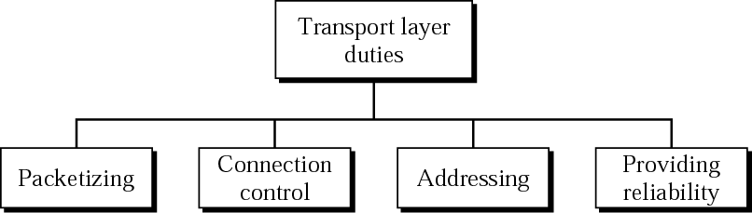
Transport layer
duties
Segmentation:
The transport layer divides large messages into smaller segments that can be easily transmitted over the network. This ensures that data can be sent in manageable chunks, reducing the risk of errors during transmission
Connection Control: managing the establishment, maintenance, and termination of connections between applications on different hosts
Error detection and correction
Acknowledgment (TCP)
Retransmission loss packets
Flow Control

Slide 12
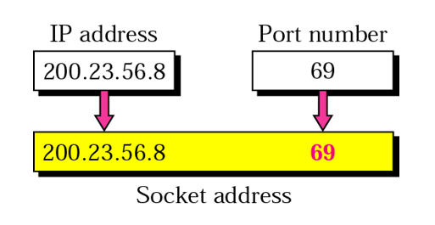
Transport layer
Application addressing
TCP uses the concept of source and destination port numbers which uniquely identify a particular communicating process on a host.
Port numbers
  Well known port numbers (defined by IANA 0 – 1023)
  Registered ports (1024 - 49151)
  Private ports/Ephemereal (49152 - 65535)
Socket Address

Slide 13
Transport layer
Tcp mechanisms
Connection establishment
  Three way handshake
  Between pairs of ports
  One port can connect to multiple destinations

Slide 14
Transport layer
Udp mechanisms
UDP is a connectionless, unreliable protocol that has no flow and error control
It uses port numbers to multiplex data from the application layer
Delivery and duplication control not guaranteed
Reduced overhead
UDP is a convenient transport-layer protocol for applications that provide flow and error control. It is also used by multimedia applications

Slide 15
Transport layer
Sctp mechanisms
SCTP – Stream Control Transmission Protocol
new transport-layer protocol designed to combine some features of UDP and TCP in an effort to create a better protocol for multimedia communication.
Services
- Process to Process Communication
- SCTP allow multi-stream service in each connection called association
if one of the streams is blocked, the other streams can still deliver their data.
- Multihoming
The sending and receiving host can define multiple IP addresses in each end for an association. In this fault-tolerant approach, when one path fails, another interface can be used for data delivery without interruption. This fault-tolerant feature is very helpful when we are sending and receiving a real-time payload such as Internet telephony

Slide 16
Exercise
Explain transport layer duty (4 duty) and give example on each duty ?

Slide 17
Books reference
Forouzan, B. A. (2021). Data Communications and Networking with TCP/IP Protocol Suite. 6th Ed. New York: McGraw-Hill. ISBN: 978-1-26-436335-3. Chapter 9

Slide 18
Thank you
December 2024

